Slide 1

HamSCI
Meteor Scatter Working Group
Nov 4, 2026
Rob Suggs Ph.D. , NN4NT
NASA Marshall Space Flight Center Amateur Radio Club
and
The HamSCI Community
nn4nt@outlook.com
robert.suggs@scranton.edu
Jay Weitzen Ph.D. , AC1SN
University of Massachusetts - Lowell
and
The HamSCI Community
jay_weitzen@uml.edu
jay.weitzen@scranton.edu

Slide 2
Agenda
Announcements
Action Item Review
HamSCI Workshop planning – Nathaniel Frissell
Scattering geometry visualization – Tom McMahan
Haystack Digital RF data format – Ryan Volz
Status of CW beacon testing – Jay Wilson
RF Sources for meteor detection – Rob Suggs
Possible tutorials on:
Shower modeling – Cooke/MEO – Nov 18
CMOR radar – Brown/UWO – Dec 2 ?
Sporadic modeling/Meteoroid Engineering Model – Cooke/MEO – Jan ?
PHARLAP/PyLAP capabilities – Hozumi – Jan 6 ?
Suggestions for future topics ?

Slide 3
Announcements

Slide 4
Action Item Review
Number | Actionee | Due Date | Description | Status
1 | Jay Weitzen | 9/23 | Investigate 1 sec Kostas coding (talk to David)
9 | Rob Suggs | 9/30 | Make GitHub doc repository private – remove copyrighted material | McKinley removed – migrate all to Sharepoint? Moved to action 11
10 | Robert Hipple | 10/14 | Report on testing of SIGMOND Meteor Scatter module | Closed 10/14
11 | Rob Suggs | 10/21 | Contact Scranton Tech Support regarding Sharepoint use | Emailed 10/25, waiting to hear. #1160387. Iterating with IT
12 | Robert Hipple | 11/4 | Work through the upload process for SIGMOND MSK144 WAV files
13 | Robert Hipple |  | Consider a dashboard to explore SIGMOND meteor scatter output. Include Tom’s ellipsoid visualization software and raytracing capability.
14
15
16
17
18
19
20

Slide 5
HamSCI Workshop Planning - Frissell

Slide 6
Scattering Geometry Visualization - McMahan

Slide 7
Haystack Digital RF - Volz

Slide 8
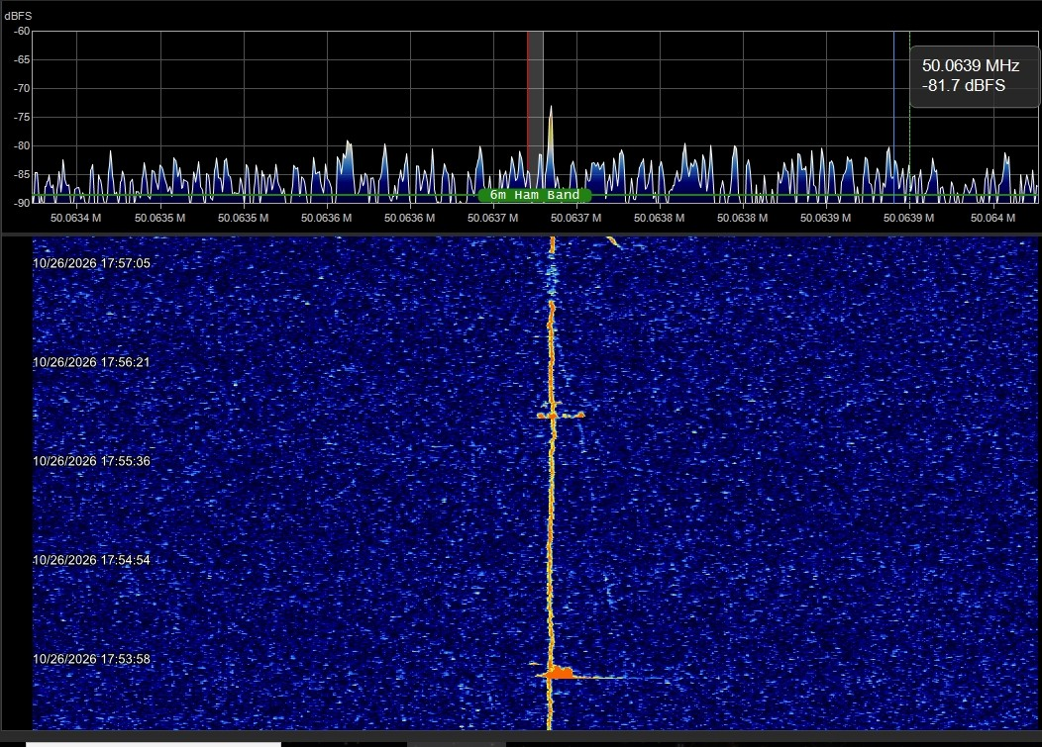
CW Beacon Testing - Wilson
I will miss tomorrow's meeting as I will be without cell service driving from Los Alamos to Socorro.
If Ted Cline checks in, he can probably share updates on our new beacon location. We have very encouraging initial reports on solid .meteor reflections.
Also, we now have nine kilowatt amplifiers for 6 meters available.
We can use input and suggestions from the group on what transmitters to use as drivers. We have three Kenwood TS-511 but frequency stability is not ideal. Chip Sufitchi can speak to that.
Affordability is a concern unless we can find an additional source of funds.
Next, we need partners willing to host a beacon.
I should make next week's meeting.
- Jay. Wilson W0AIR

Slide 9
RF Sources for Meteor Scatter - Suggs
RF Sources for Meteor Radar
Suggs 10/23/26 |  |  |  |  | Utility for Meteor Science
Source | Freq Range | Power level | Notes | Modulation | Pros | Cons | Compatible Software
Amateur MSK144 | 28, 50, 144 MHz | <1500 W | Most are 100 W and small antennas | MSK144 | Messages contain source callsign and location | Only available when someone is transmitting | WSJT-X, Sigmond
 |  |  |  | MSK (a form of OQPSK) |  | No way to measure doppler
Digital Television Pilot Tone | 54 - 88 MHz | ? |  | CW | Available 24/7 | Determining TX location for each audio freq can be difficult | NASA Counting Software
 |  |  |  |  | Different TX are slightly separated in RX audio passband | Fairly weak, tone is tiny fraction of transmitter power
Amateur CW beacons | TBD | 30 - 1500 W |  | CW | Available 24/7 |  | To be developed
May be licensed for other frequencies and higher power |  |  |  |  |  |  | See Balis+ 2025
Professional meteor radars | 17.45, 29.85, 38.15 MHz | 15 - 130 kW | CMOR | Pulsed 532 Hz, 70 μsec | Available 24/7 | Processing complexity | To be developed
 |  |  |  |  | We know their locations
 | 31.65 MHz | 500 W | SIMONe | coded CW

Slide 10
Backup

Slide 11
N4WLO Beacons EM50uo – Tim Urban
50.218600 MHz USB audio 1500 Hz Carrier 2 element Yagi at 11 ft pointed at 20 degs. GPSDO
50.230000 MHz USB MSK144 3 element Yagi at 11 ft pointed at 20 degs. Not GPSDO
28.19900 MHz USB audio 1500 Hz FT8 and CW Moxon 70 ft pointed at 200 degs. Not GPSDO
  FT8 followed by CW (N4WLO) every 5 mins (0,5,10,15,20,25,30,35,40,45,50 and 55)
Seconds 00 to 15 FT8
Plan to return to transmitting GPS PPS also
Info from email from Tim Urban 12 Oct 2026.

Slide 12
Homework – Read/view the following
Weitzen and Ralston MS review paper https://github.com/HamSCI/MSQP/blob/main/Weitzen_and_Ralston_Meteor_scatter_an_overview.pdf
Suggs’ HamSCI talk/slides https://www.hamsci.org/sites/default/files/article/Workshop_2026/Meteor_Scatter_Science_Behind_the_Pings_HamSCI_conference_RevB.pdf
https://www.youtube.com/watch?v=1pgrXqg435g&t=3s
Balis+ – example of what can be done with CW forward scatter
McKinley chapters - contact Rob Suggs for copies
MSK144 Protocol https://github.com/HamSCI/MSQP/blob/main/MSK144_Protocol_QEX.pdf
CMOR radar info https://aquarid.physics.uwo.ca/research/radar/cmor_intro.html

Slide 13
Strategy for MSQP data analysis – West and Suggs

Slide 14
Topics discussed with Peter Brown
Nathaniel – HamSCI introduction including PSWS
Peter – Problems in meteor science which forward scatter might address
  Balis+ 2025 CW beacon thoughts – need dense network, at least 6 receivers per meteor to measure speed and trajectory. US beacons plus PSWS network?
  GMN data fusion – could be useful, gives trajectory (range especially needed), larger meteors (we might hear head echoes)
  CMOR characteristics
  29.850 MHz going from 15 kW peak to 130 kW peak (end of Oct)
  5% duty cycle
  532 Hz PRF, 70 microsec Gaussian pulses, non-coded, 25 kHz BW
  Product would be radiant tomography (Fresnel Transform Tomography from IQ, but need range)
Jay – Problems in meteor scatter communications and waveform requirements - ground footprint for communications, multipath limits data rate
Measuring CMOR radar signals could be useful. Start listening.
Rob – Forward scatter modeling with PHARLAP/PyLAP
          Interest in scattering resonance near the specular point – physical properties of ionization trail
          Polarization (Faraday rotation) hasn’t been dealt with except as error in amplitude

